Slide 1
SC1015
Earthquake Magnitude Prediction
Done by:
Nicholas Tan U2322167G
Tan Wei Hui U2321105A
Notes:
Good morning everyone and welcome to our Earthquake Magnitude Prediction presentation.

Slide 2
Motivation

Slide 3
Case Study of Earthquakes
Taiwan's strongest earthquake in 25 years in 2024
9 Deaths
Earthquakes affect social life as they cause loss of life, injury, material damage, and psychological destruction
(Maki et al., 2019)
900 injured
50 Missing
Notes:
In the recent earthquake that happened in taiwan, we’ve see the devastating aftermath of Taiwan’s strongest earthquake after 25 years. This is the result of any earthquake that had and can happen. Earthquake can not only unruly snatch the lives of people, they can cause a great scale of physical destruction and trauma, affecting from an individual to a nationwide level. And because of the great scale of destructions it can cause, many countries, particularly for countries who are susceptible to these seismic events, have tried to mitigate its impact, long-term and short-term, through earthquake prediction.

Slide 4
Earthquake Prediction
01
02
03
Data & Time
Location
Magnitude
Notes:
Earthquake prediction aims to forecast the occurrence of earthquakes by providing estimates of their magnitude and accurate location. So in earthquake prediction, we can see that it involves three key elements: the date and time, the location, and the magnitude. Our project will concentrate on predicting the magnitude of earthquakes.

Slide 5
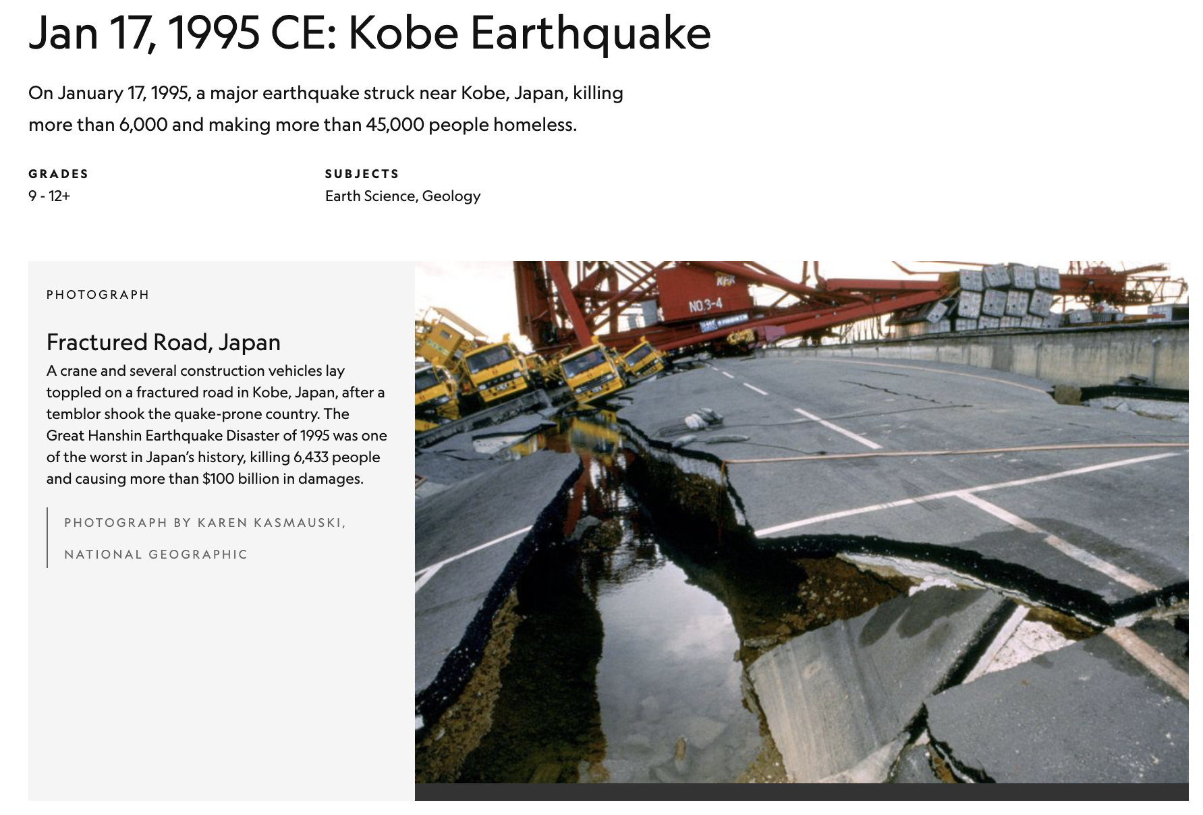
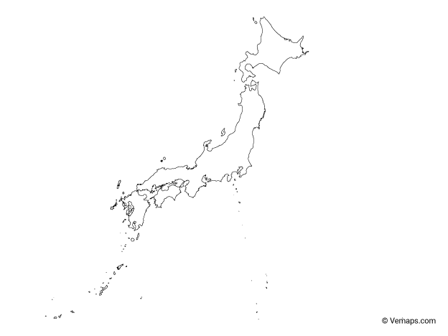
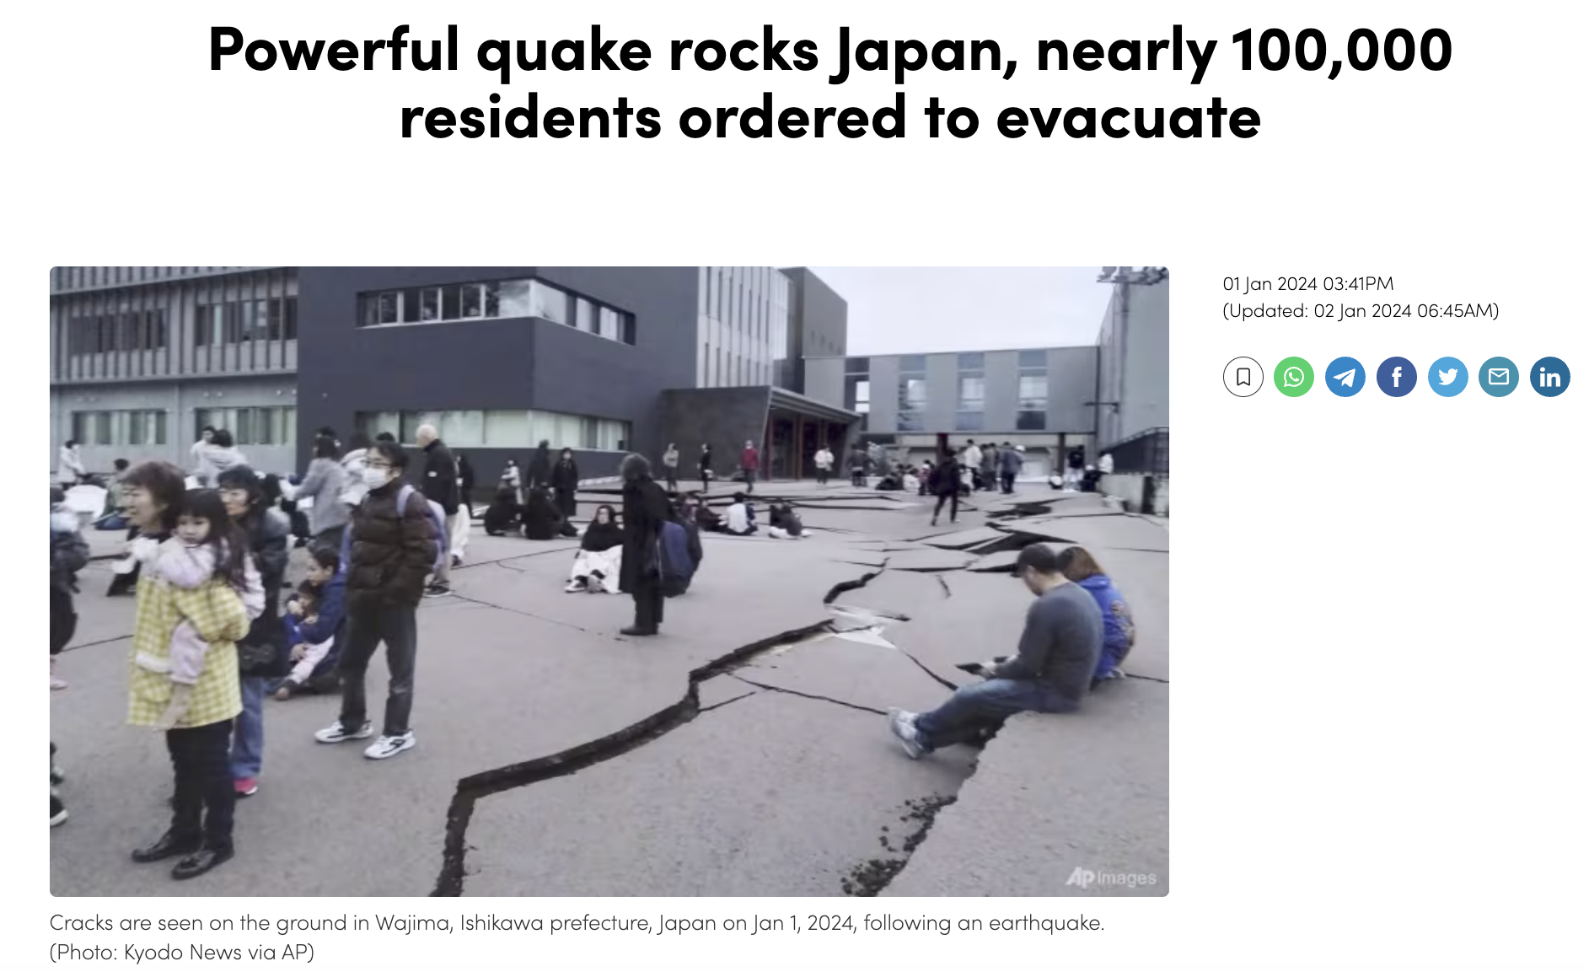
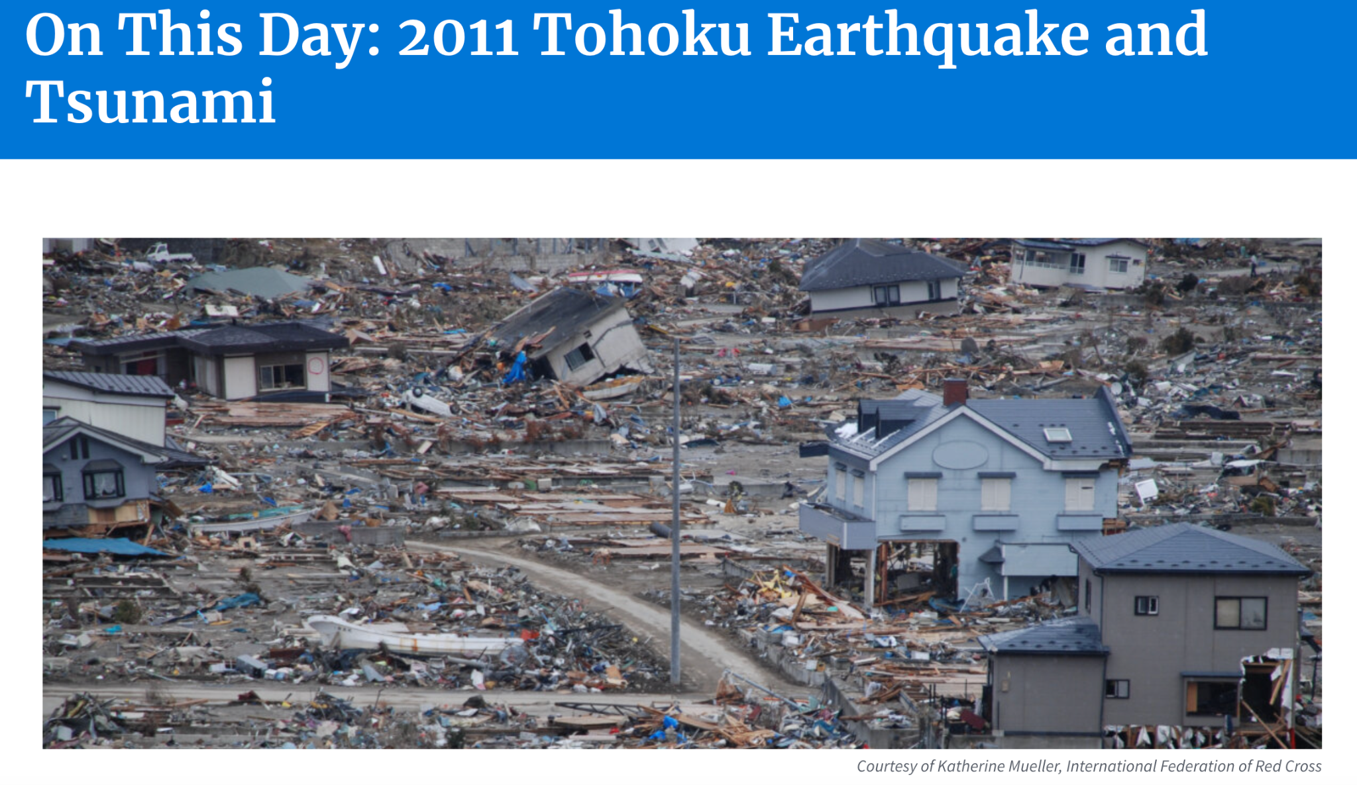
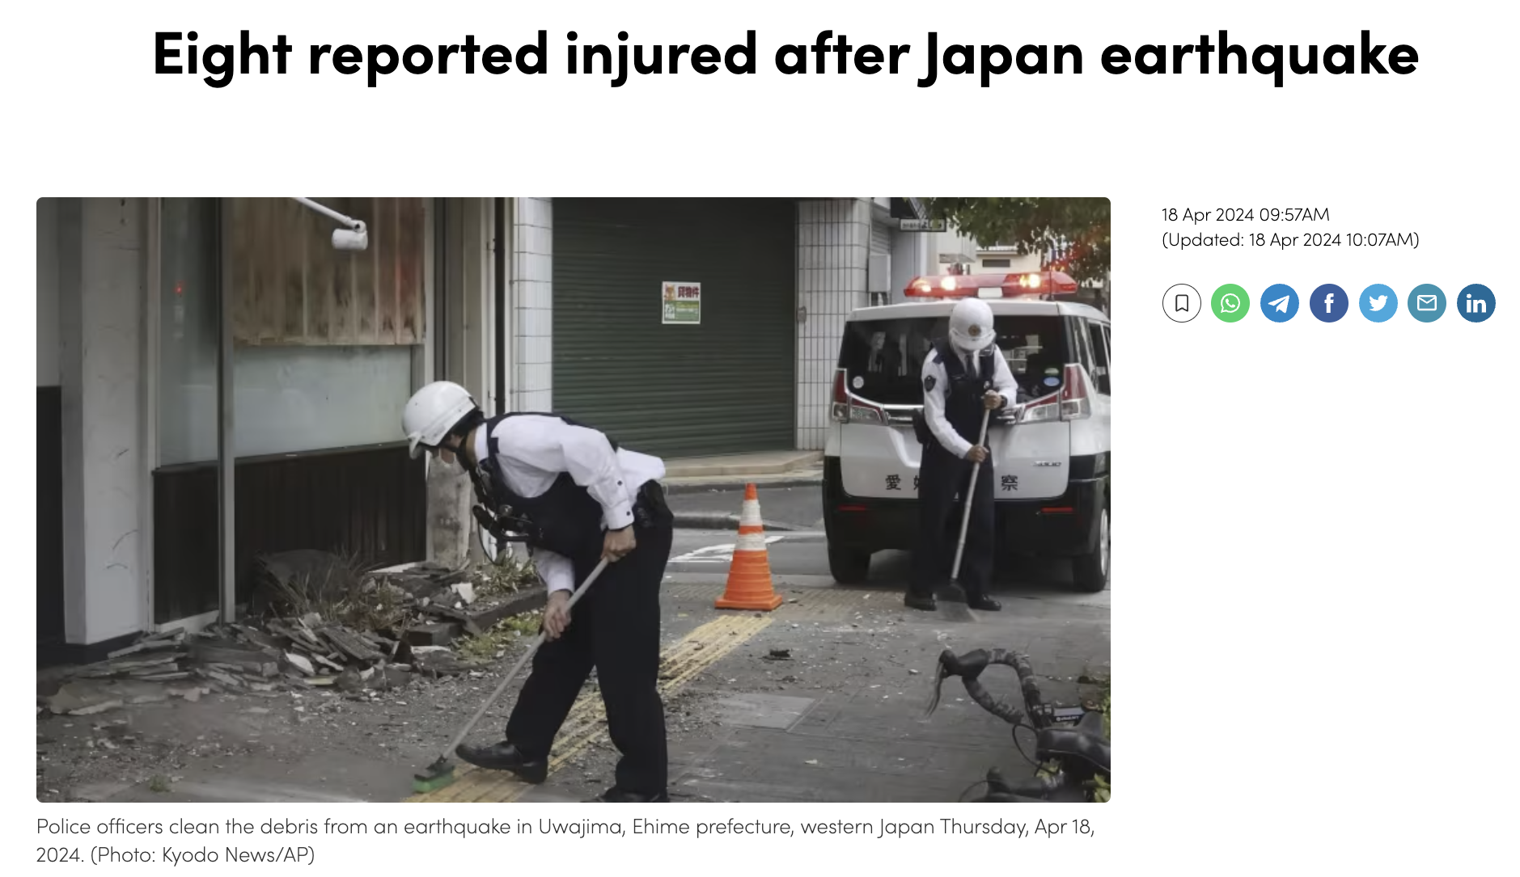
Japan
Notes:
In our project specifically, we will focus on Japan, a nation with significant seismic activity. By honing in on Japan, we have access to an extensive dataset of historical seismic records across various magnitudes. This wealth of data enables us to enhance the accuracy of our models and predictions.

Slide 6
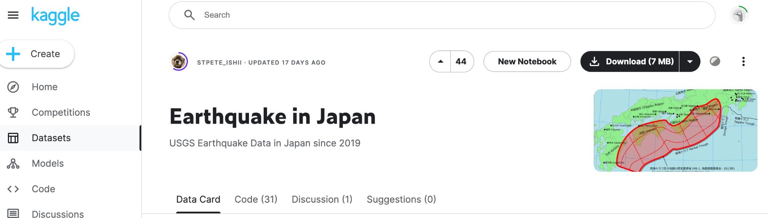
Notes:
For our earthquake magnitude prediction, we will be utilising the japan_2000_2023_query dataset in this earthquake in japan notebook from kaggle. This dataset will allow us to study relationships with magnitude from the period 2000-2023.

Slide 7
Problem Definition
&
Goal
Notes:
Now moving on to our problem definition and our aim

Slide 8
Our Problem Statement:
How can we optimise machine learning algorithms to help enhance earthquake magnitude prediction in Japan?
Our goal: To harness our dataset for identifying patterns and relationships pertinent to earthquake magnitude prediction, aiming to minimise the adverse effects of earthquakes in Japan
Notes:
Our overarching problem is how can we utilize machine learning algorithms to help enhance earthquake magnitude prediction in Japan? By harnessing our dataset for identifying patterns and relationships pertinent to earthquake magnitude prediction, we aim to minimise the adverse effects of earthquakes in Japan. The utilization of machine learning techniques will enable us to analyze the data more effectively, leading to improved predictive models that can better inform disaster preparedness and response strategies in the country.

Slide 9
Why will we not include damage dataset?
We did not include damage dataset (e.g. death count/ economic losses) due to the following reasons:
Inaccuracy and data completeness, especially in rural areas where such data can be underreported
Such data it involves data sensitivity and ethics
Assumption:
If magnitude can be predicted -> sufficient measures can be taken -> damage is minimise
Notes:
Before we begin with our analysis, we just wanted to state that we chose not to include damage dataset (e.g. death count/ economic losses) as it involves inaccuracy and data incompleteness, especially in rural areas where such data can be underreported. Also, such data usually involves data sensitivity and ethics, which may also lead to inaccuracy. Hence our sole indicator of whether the adverse impact is successfully minimised will be based on magnitude prediction. The assumption we will be making here will then be if magnitude can be predicted, sufficient measures can be taken by relevant authorities and hence minimising the damage.
We did not include damage dataset (e.g. death count/ economic losses) due to the following reasons:
Inaccuracy and data completeness, especially in rural areas where such data can be underreported
Such data it involves data sensitivity and ethics

Slide 10
Data Collection & Preparation
Notes:
Now moving on to our data collection and preparation
You MUST mention how you collected / curated / cleaned / prepared the data for this problem.
Did you only use tools and techniques learned in this course? What ELSE did you learn / try?

Slide 11
Data cleaning and preperation
Check
&
remove duplicates
01
02
Removing outliers
Handling missing
values
03
Feature creation
/ removal
04
Filling with median
Number of stations (nst)
Number of stations recording magnitude (magNst)
Depth
Filling with NAN :
horizontalError
depthError
magError
Drop
magni†ude

Slide 12
Finals features
removed
gap
dmin
rms
net
id
updated
place
type
status
locationSource
magSource
kept
time
latitude
longitude
depth
mag
nst
magNst
horizontalError
depthError
magError
created
day
month
year
season
mag_category
normalised_magnitude

Slide 13
Exploratory Data Analysis
&
Data Visualisation
Notes:
Present your Exploratory Data Analysis and some initial data-driven Insights from the dataset.
You MAY also mention how you are planning to set up the Analysis / ML problem for this case.
Did you only use tools and techniques learned in this course? What ELSE did you learn / try?

Slide 14
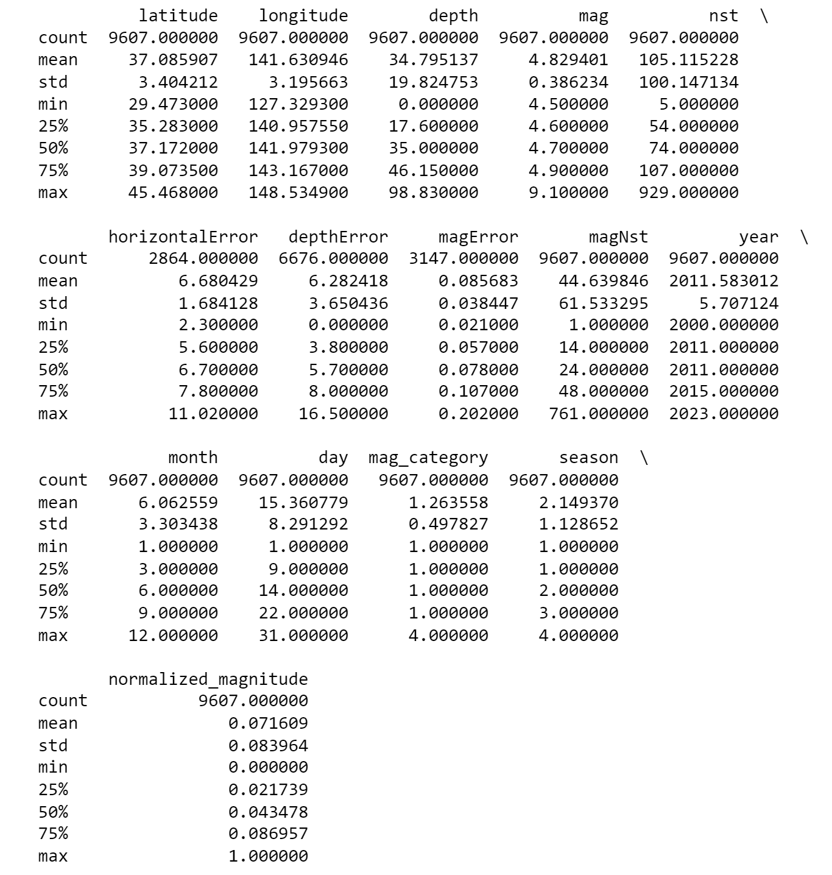
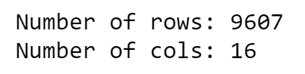
Basic Information

Slide 15
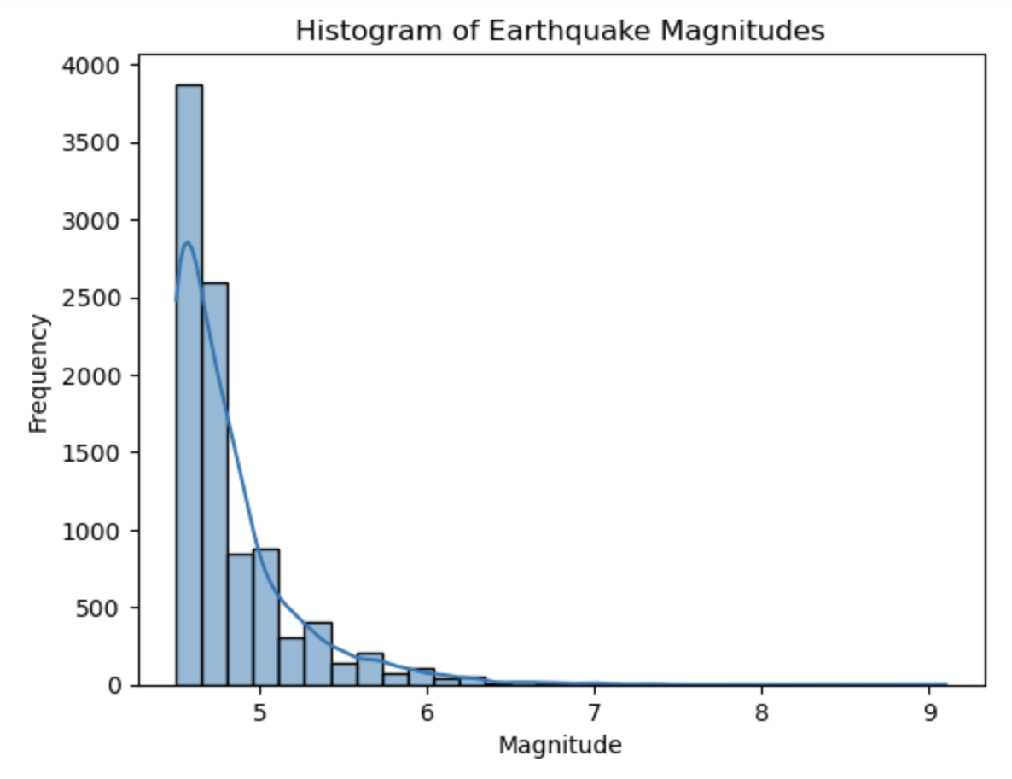
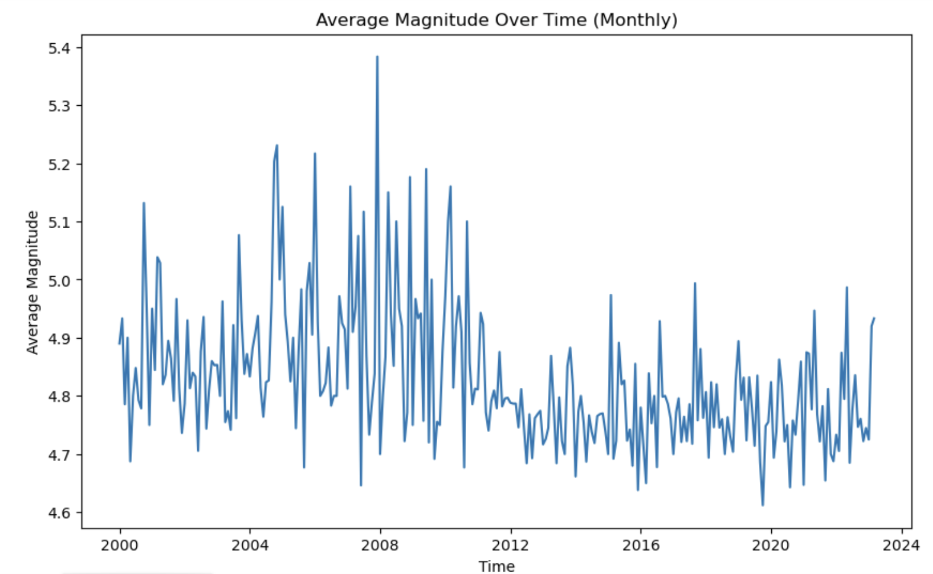
Trend of Earthquake Magnitude
Notes:
We began by examining the distribution of earthquake magnitudes over time. Our histograms revealed that lower magnitude earthquakes occur more frequently, which is not surprising as it is well-known fact in seismology. However, it's the less frequent, higher-magnitude earthquakes that often have the most significant impact, underscoring the importance of accurate prediction.

Slide 16
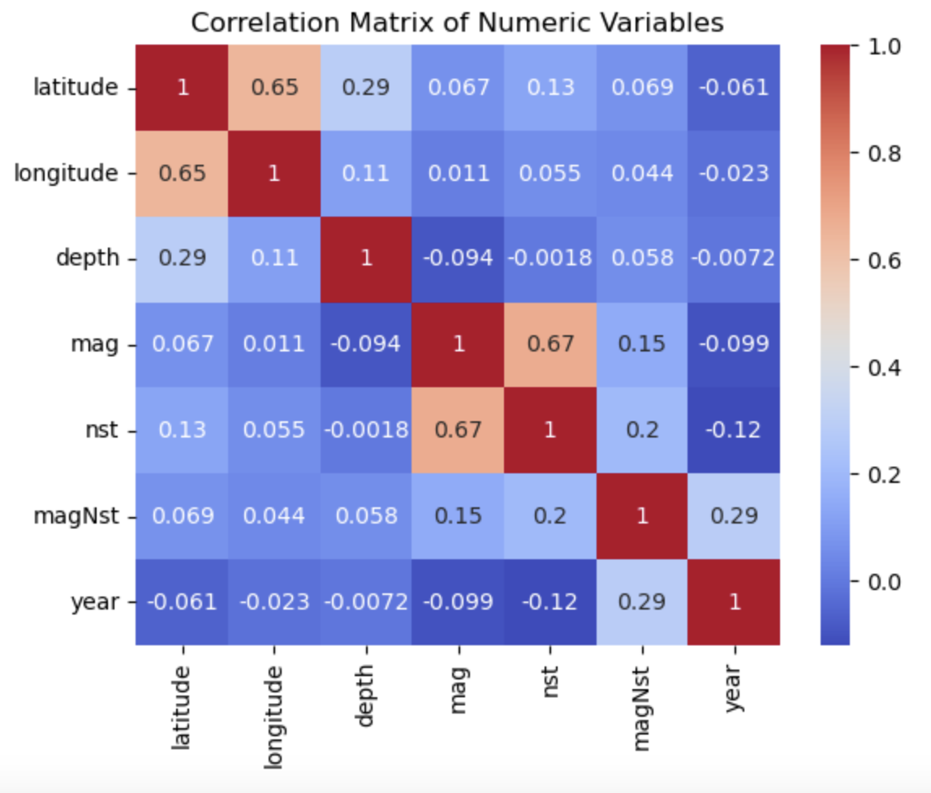
Heatmap of variables with magnitude
Notes:
Next, we looked at the correlation between various factors and earthquake magnitude. Through our heatmap analysis, we found that even tho latitude and longitude have a significant positive correlation (0.64), which indicates a relationship between the geographical location of earthquakes, when INDIVIDUALLY ON THEIR OWN, they have very low predictive power of mag. In this heatmap, 'mag' shows a relatively strong positive correlation with 'nst' (0.67). However, before we touch on nst, since both latitude and longitude shows high correlation to each other, we suspect that there might be some relations between the two to earthquake, hence, we decided to explore more with the two. We will first plot these two variables as coordinates on the map of japan

Slide 17
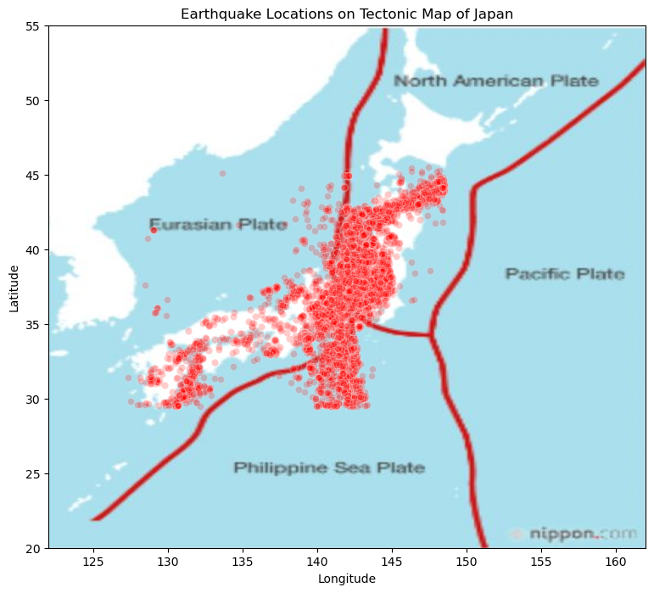
Japan earthquakes on tectonic plate mapping
Relationship of longitude and latitude to magnitude
Notes:
That’s what we did here, we plotted all earthquake occurrences onto a tectonic map of Japan. From this visual representation, it's clear that there is a significant concentration of earthquakes along the boundaries of tectonic plates near Japan. This clustering of earthquakes near plate boundaries is consistent with seismic activity generated by the movement of tectonic plates, which is a well-understood phenomenon in geology. The map indicates that Japan's geographic location is a major factor contributing to its high seismic activity. This information is vital for understanding regional seismic risks and for the development of earthquake preparedness strategies.

Slide 18
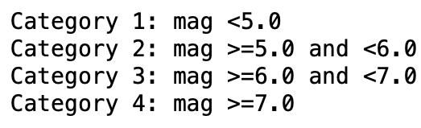
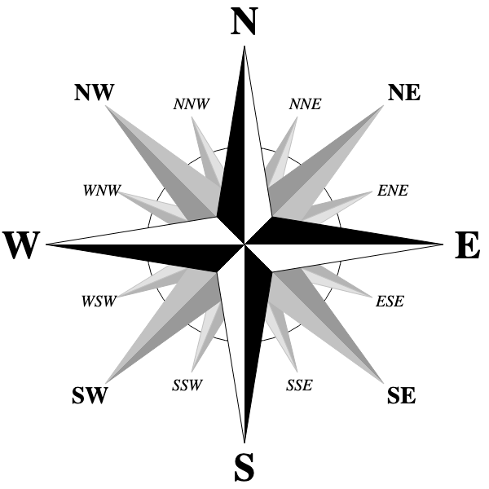
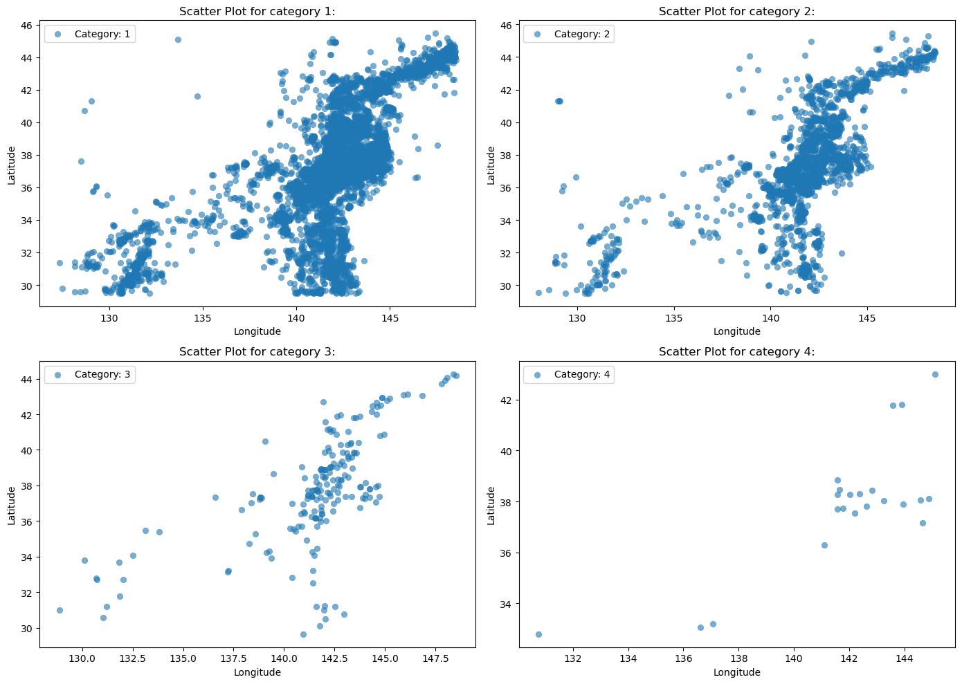
Spatial distribution based on categories of magnitude intensity
Relationship of longitude and latitude to magnitude
Categories | Magnitude Range
1 | < 5.0
2 | 5.0 - 6.0
3 | 6 - 6.9
4 | > 7.0
Notes:
However since the previous diagram shown seems to show earthquake happening in the whole of japan and gave us little to no information with regards to the magnityde, we decided to separate the earthquakes and cluster them according to 4 different range of magnitude intensity shown on the bottom right table. By doing so, we observed a compelling spatial distribution of earthquake magnitudes, particularly in categories 3 and 4, depicted in the scatter plots. Notably, there is a higher occurrence of significant seismic events at greater latitudes and longitudes, indicating a pronounced trend of larger earthquakes in the northeastern regions. This pattern aligns with known tectonic plate interactions and highlights the importance of including geospatial factors in our predictive models for earthquake magnitudes. Such insights are crucial for enhancing earthquake preparedness and risk mitigation strategies in areas more susceptible to greater seismic activity.

Slide 19
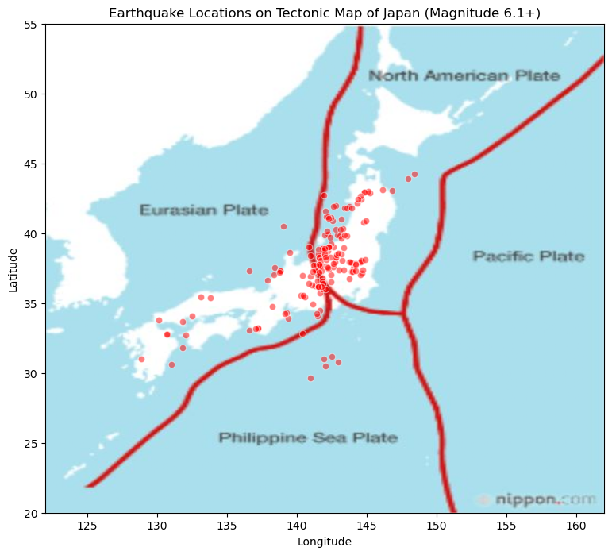
Japan’s ‘strong’ earthquakes
Relationship of longitude and latitude to magnitude
Magnitude | Earthquake Effects
2.5 or less | Usually not felt, but can be recorded by seismograph.
2.5 to 5.4 | Often felt, but only causes minor damage.
5.5 to 6.0 | Slight damage to buildings and other structures.
6.1 to 6.9 | May cause a lot of damage in very populated areas.
7.0 to 7.9 | Major earthquake. Serious damage.
8.0 or greater | Great earthquake. Can totally destroy communities near the epicenter.
Notes:
We then took the larger earthquake occurrence and plotted back its location on the map for a clearer visualisation. We can see that indeed places nearer to the tectonic lines, in the northeastern region are more susceptible to larger earthquakes, showing the importance of considering location with respect to tectonic lines in earthquake magnitude prediction. The occurrence of larger scale earthquake should be expected and prepared for in these areas.

Slide 20
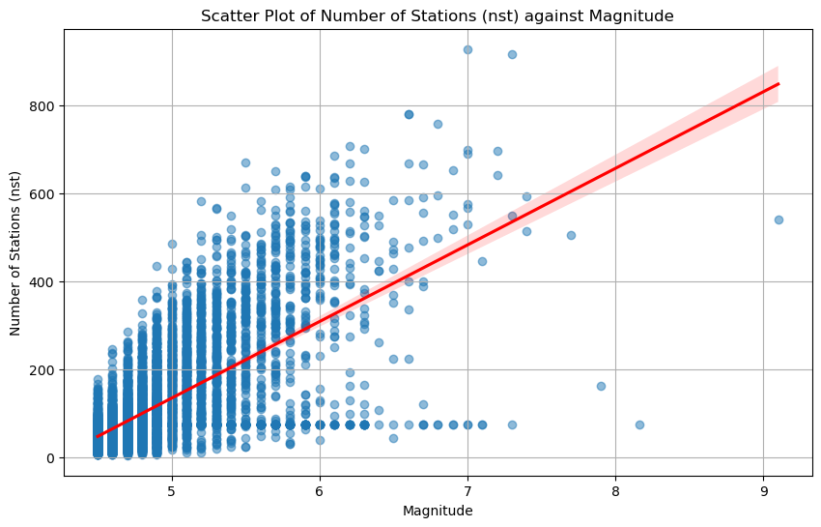
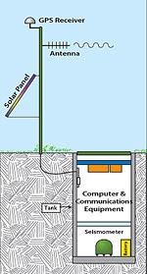
Number of Stations (nst) vs Magnitude
Relationship of number of stations to magnitude
Seismic station
Notes:
Next we decided to look at another feature that seemed promising, nst, which is the number of stations that detected and captured the seismic activities from earthquake. Since, the stations showed the highest correlation among all our other variables with respect to magnitude, we will now explore role of reporting stations. We noticed a correlation between the number of stations that report an earthquake and its magnitude. However, even tho the relationship is likely reflective of the detection process rather than the physical characteristics of the earthquakes, this can still show how the seismic activity of earthquakes of greater magnitude tend to be detected by more stations. This means that if more stations capture its activity, its more likely that it will be an earthquake of greater magnitude.

Slide 21
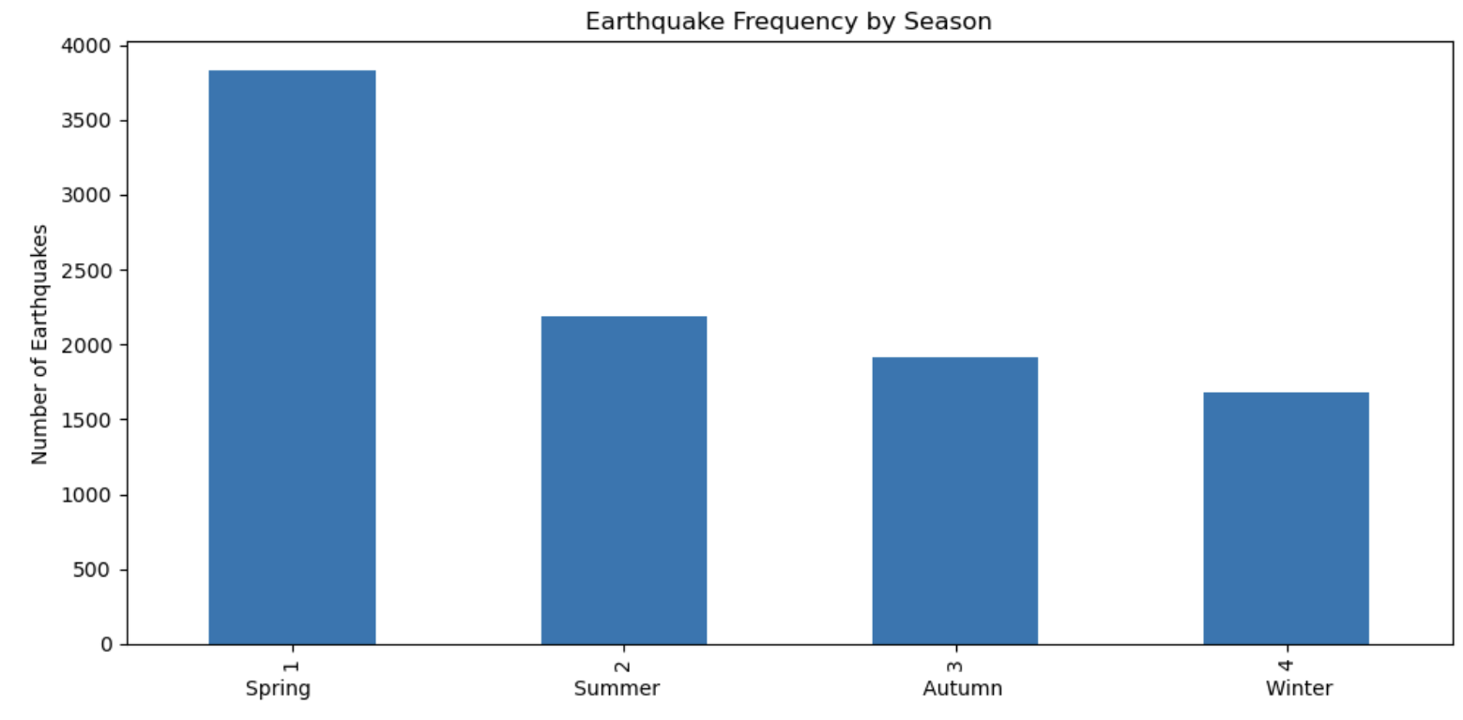
Something interesting…

Slide 22
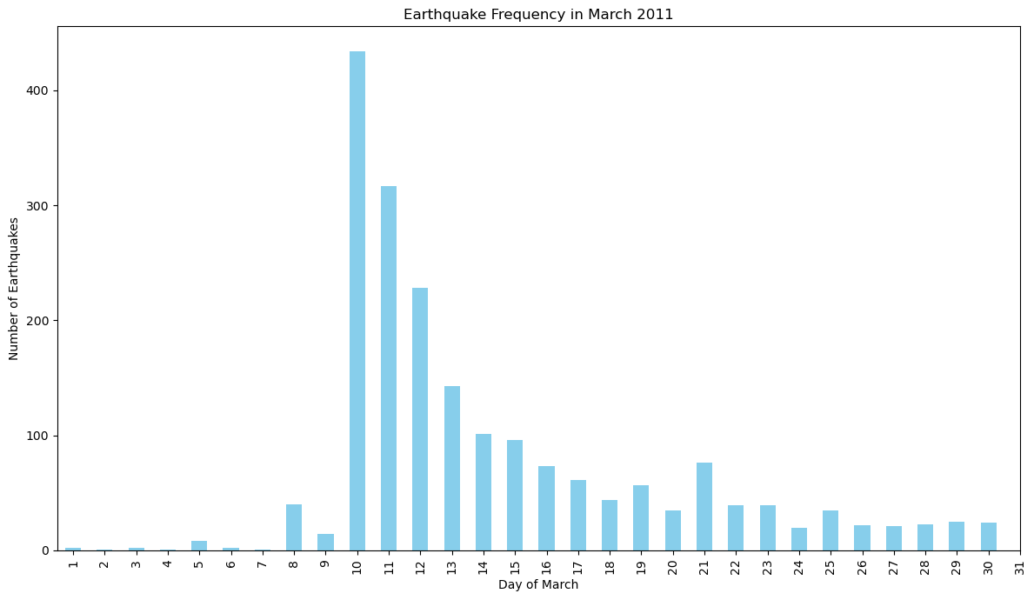
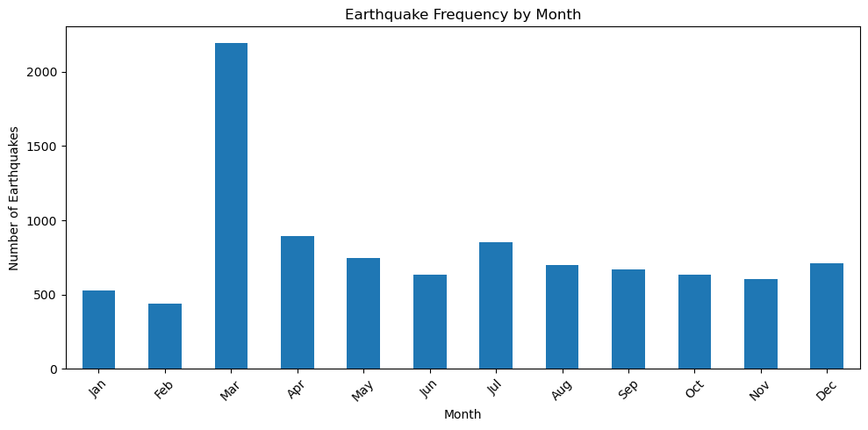
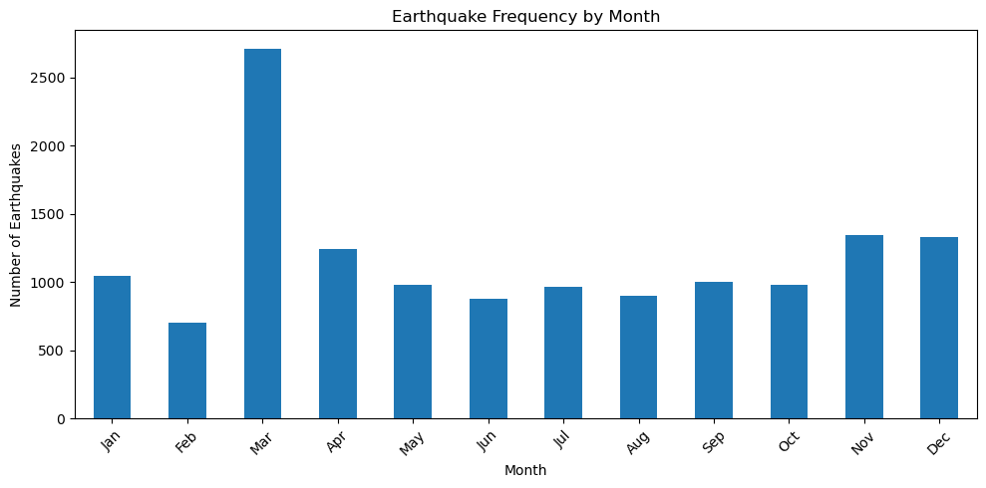
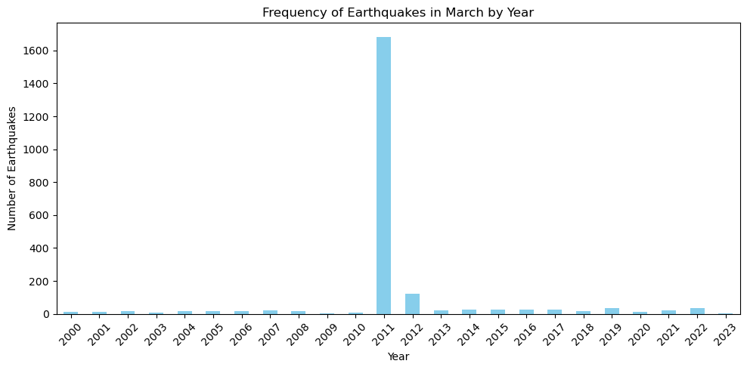
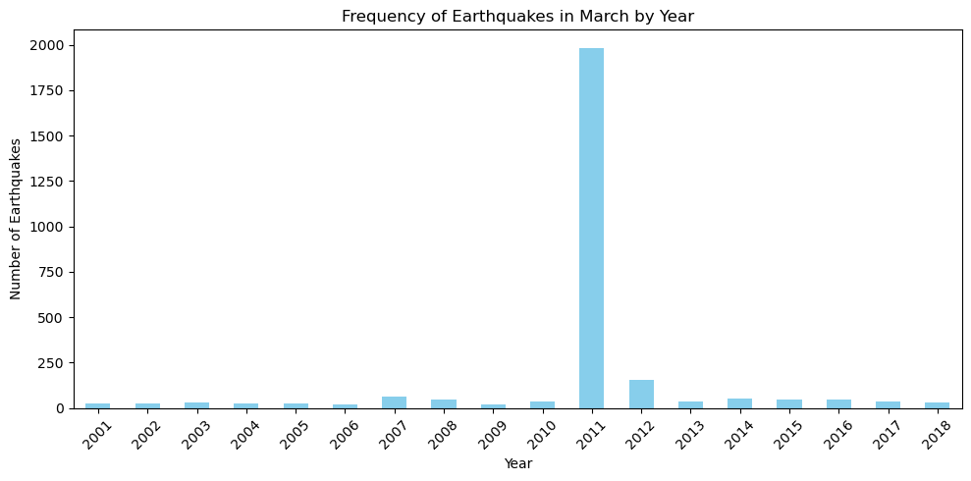
Primary dataset for the project (2000-2023)
External dataset to verify (2001-2018)

Slide 23
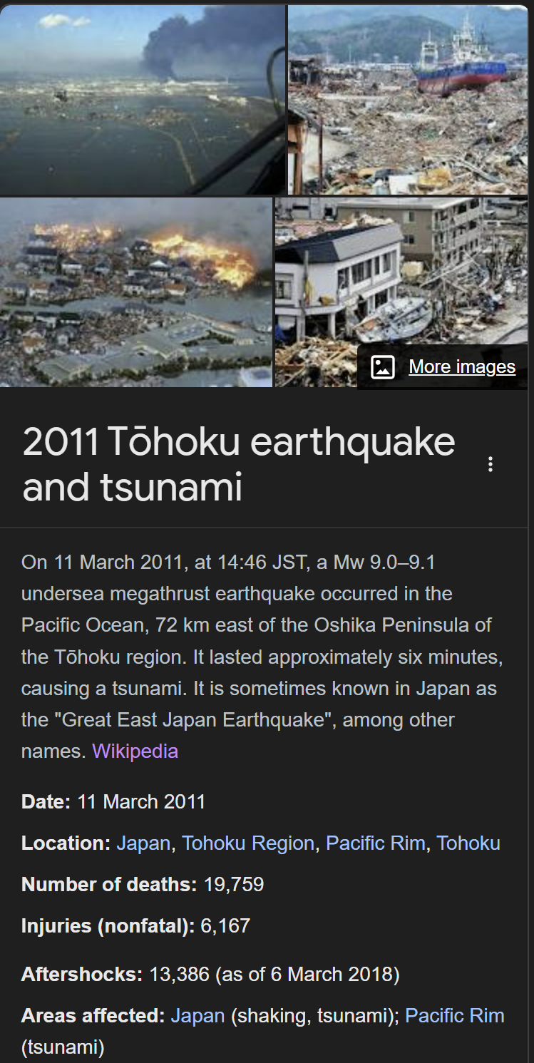
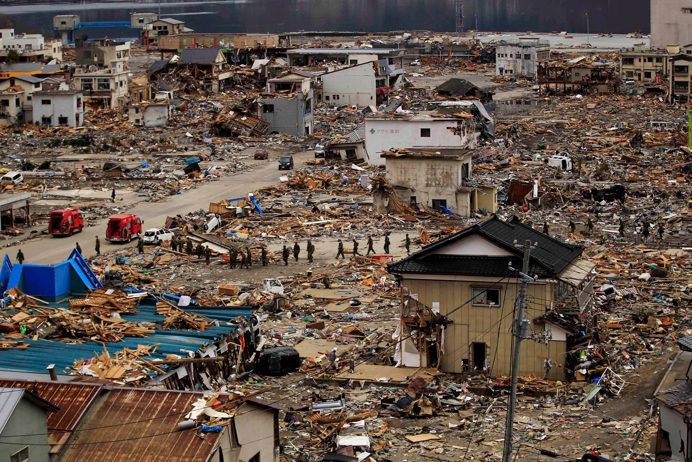
11 March 2011 Tohoku earthquake & tsunami

Slide 24
Machine Learning
Notes:
Next, we move on to the Machine Learning portion. Machine Learning helps us to predict earthquake magnitudes by analyzing complex patterns in seismic data. For Japan, this translates into better preparedness and more effective risk mitigation for natural disasters.

Slide 25
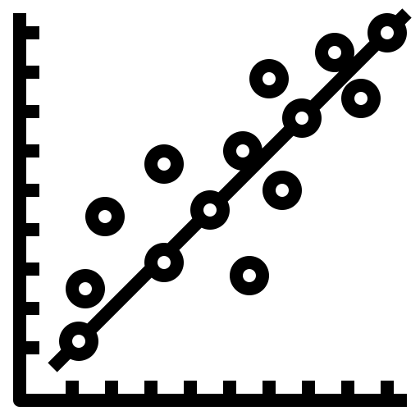

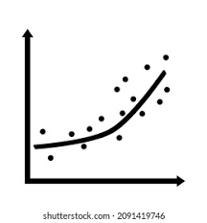
Models
1
1
2
3
1
2
3
Linear Regression
Random Forest
Polynomial Regression
an ensemble learning method that builds multiple decision trees and combines their predictions to make more accurate and robust predictions. Each tree is trained on a random subset of the data and features.
extends linear regression by fitting a polynomial function to the data instead of a straight line. It can capture nonlinear relationships between predictors and the dependent variable
models the relationship between the independent variables (features) and the dependent variable (earthquake magnitude) by fitting a linear equation to the observed data.
Notes:
We loaded the dataset and prepared feature matrices, target variables for modeling, and the 80-20 train test data. We made use of 3 regression models, but we're we'll go through and start things off with initializing and training a linear regression model.
Did you only use tools and techniques learned in this course? What ELSE did you learn / try?

Slide 26
Models
1
1
grasp direct relationships between seismic features and earthquake magnitudes.
identify features most clearly impacting magnitude changes
quickly put together a model that can immediately aid in disaster response efforts
2
3
Linear Regression
Notes:
Linear regression models are fundamental predictive modeling technique used for understanding the relationship between the features we've filtered and created and a continuous target variable, in our case, magnitude.
The model then produced the Mean Squared Error (MSE) which is a common metric for evaluating regression models, giving an average of the squares of the errors between predicted and actual values. For linear regression model, it produced an MSE of close to 0.07
Did you only use tools and techniques learned in this course? What ELSE did you learn / try?

Slide 27
Models
manages numerous features effectively and avoids overfitting suitable for Japan's complex geological data..
enhances the accuracy of earthquake magnitude forecasts using combination of predictions from multiple decision trees
more effective evacuation strategies and optimise resource allocation
1
2
2
3
Random Forest
Notes:
We did the same with training a Random Forest model, which is a more complex and often more accurate model than linear regression, due to its ability to capture non-linear relationships between features and the target variable. This produced an MSE of 0.052.
Did you only use tools and techniques learned in this course? What ELSE did you learn / try?

Slide 28
Models
incorporating higher-degree terms allowing complex patterns model often found in seismic data.
flexibility in curve fitting provides a deeper understanding of seismic activity patterns in Japan, improving long-term earthquake forecasting and planning
helps develop infrastructure and community plans that better withstand earthquakes.
1
3
2
3
Polynomial Regression
Notes:
We did the same with training a Random Forest model, which is a more complex and often more accurate model than linear regression, due to its ability to capture non-linear relationships between features and the target variable. This produced an MSE of 0.052.
Did you only use tools and techniques learned in this course? What ELSE did you learn / try?

Slide 29
Mean Squared Errors
1
Linear Regression
2
Random Forest
3
Polynomial Regression
Notes:
And we also trained a polynomial regression which can also model more complex relationships than linear regression by considering polynomial features. This produced an MSE of 0.064
Did you only use tools and techniques learned in this course? What ELSE did you learn / try?

Slide 30

Cross Validation
Notes:
We then performed cross-validation for linear, Random Forest, and polynomial regression models. Cross-validation is a powerful technique used to assess the effectiveness of your machine learning models, ensuring that they generalize well to new data. It helps mitigate problems like overfitting and gives a more reliable estimate of how our model will perform on unseen data. This is a crucial step in assessing the general effectiveness beyond the specific subset of data used for training. In this case linear regression had the lowest cross validation mse score, but we're not done here yet.

Slide 31
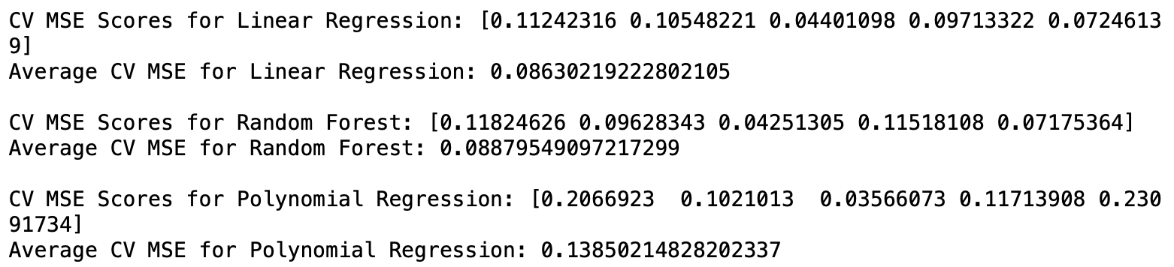

Slide 32
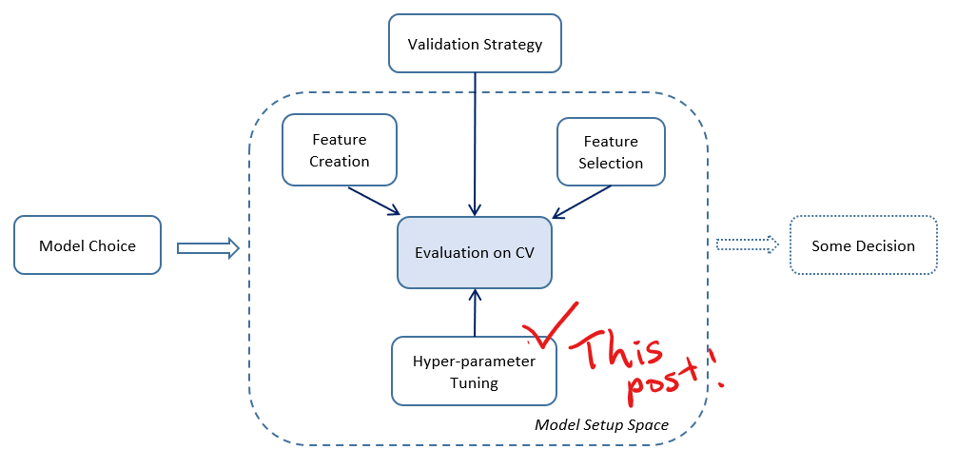
Hyperparameter tuning
Notes:
How do we ensure our models are the best they can be? This is where hyperparameter tuning comes in. Think of hyperparameters as the settings of the model that we can adjust to improve performance. This process is cruicial as it is about finding the right balance between underfitting and overfitting. We used a method called Grid Search to systematically test different combinations of these settings and select the best ones. In our Random Forest model, for example, hyperparameters like the number of decision trees and the maximum depth of these trees were optimized using Grid Search, leading to an enhanced version of the model. This improved our MSE score by 30%, reducing it from 0.086 to 0.061. This was the best score we had amongst all the versions of the models that at the same time striked balance between over and under fitting

Slide 33
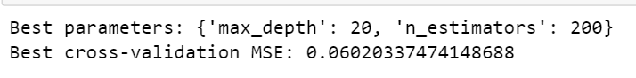

Random Forest Model with Hyperparameter tuning
Polynomial Regression with Hyperparameter tuning

Slide 34
Overview of Mean Square Error values
 | MSE | Cross Validation MSE
Linear Regression | 0.081 | 0.086
Random Forest | 0.068 -> 0.067 | 0.089 ->0.060
Polynomial Regression | 0.074 -> 0.081 | 0.14 -> 0.075
*result in green are after hyperparameter tuning

Slide 35
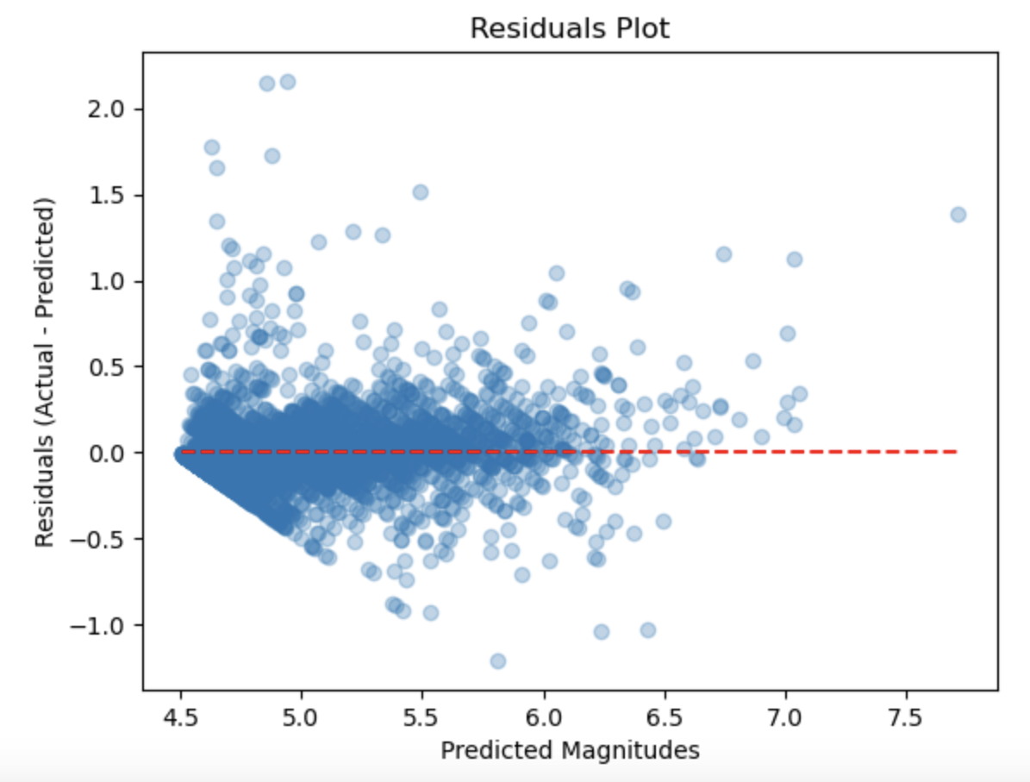
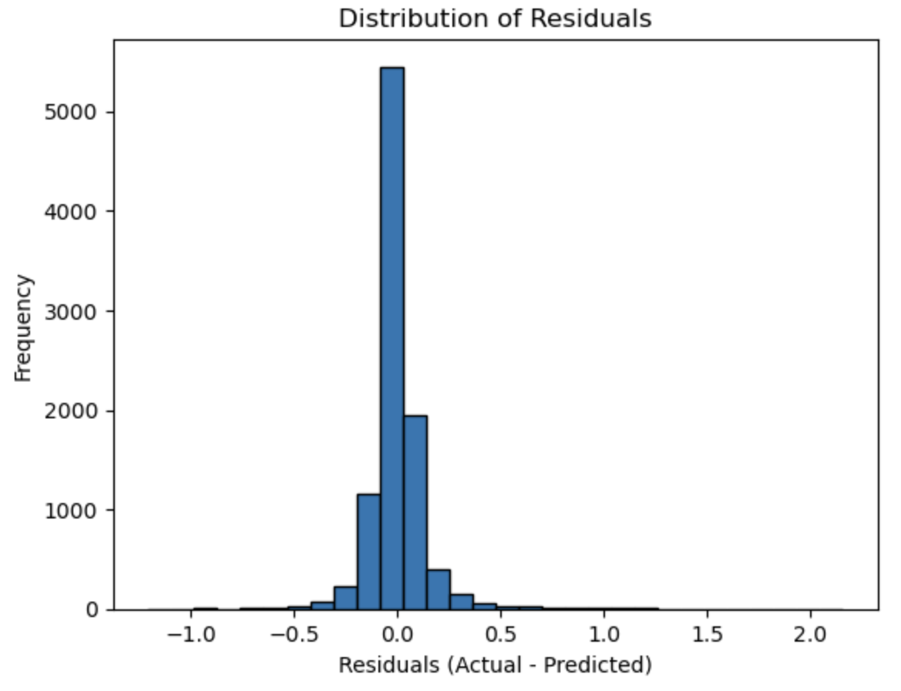
Residual Plots
Random Forest
Notes:
Visualization played a key role in our project. We plotted residuals, which are the differences between the predicted and actual magnitudes, to identify any patterns or biases in our predictions. For the left residual plot, the concentration in the center suggests that for many predictions, the residuals are close to zero, which is good. However, the spread along the horizontal axis suggests that the prediction error still varies, indicating it might not perform uniformly across all magnitudes. Its accuracy can be better seen in the histogram where the peak near zero suggests that the model is generally accurate, as most residuals are close to zero. However it can still be seen that there are errors and is slightly right-skewed

Slide 36
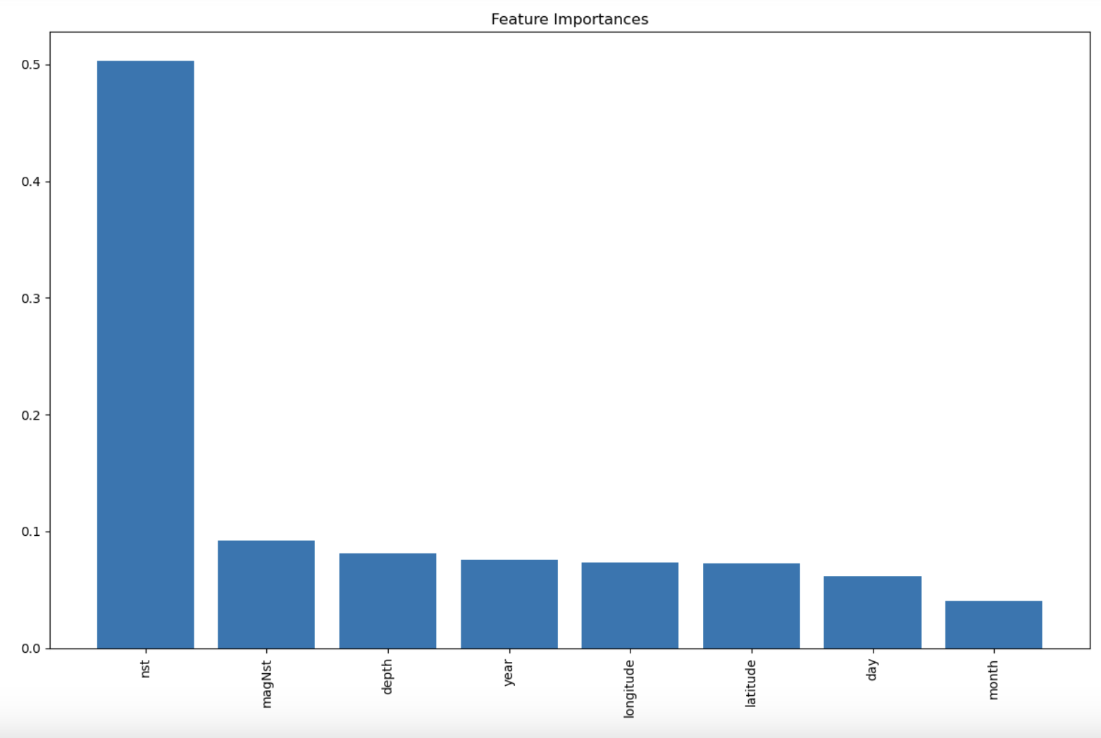
Feature Importance
Notes:
Finally, we examined the feature importances in the Random Forest model to determine which factors are most influential in predicting earthquake magnitudes. This not only provides model transparency but also offers valuable geological insights. as you can see it also state that with respect to individual feature, nst had the greatest predictive importance.

Slide 37
Outcome
Notes:
So what do all these mean? As you can see,the Mean Squared Error guided us in comparing models quantitatively. It not merely a random statistic —it carries important and practical implications, especially for a nation like Japan that is frequently subject to seismic activity. By striving for lower MSE, we improve the model's accuracy and aimed for predictions that are as close to the actual magnitudes as possible, thereby improving the predictive power of our models.

Slide 38
Outcomes
Linear Regression model serves as a baseline before a more complex model is formulated
Random Forest and Polynomial Regression are more accurate representations
Our model is able to predict earthquake magnitude to a certain level of accuracy (theoretical)
However in reality, earthquake prediction remains a challenge for everyone:
Recall 3 components involve, prediction on when and where is a challenge itself
Any prediction up to date is only a probability

Slide 39




Insights gained & Recommendations
Integrated Multi- modal Approach
01
Random Forest the better candidate for this predictive modeling of earthquake magnitude task
Linear Regression could not perform as well due to the underlying non-linear patterns and relationships
02
Enhance monitoring infrastructure
Polynomial performed slightly better than linear but was still outperformed by Random Forest
03
Public Education & Drills
Notes:
What are your data-driven INSIGHTS and recommendations / views towards the target problem?

Slide 40
References
https://www.usgs.gov/faqs/can-you-predict-earthquakes
https://www.analyticsvidhya.com/blog/2022/01/different-types-of-regression-models/https://www.ibm.co
m/topics/random-forest#:~:text=Random%20forest%20is%20a%20commonly,both%20classification%2
0and%20regression%20problems.
https://scikit-learn.org/stable/modules/cross_validation.html
https://towardsdatascience.com/hyperparameter-tuning-explained-d0ebb2ba1d35
https://twitter.com/imAdityaRathore/status/1745531019854221809
http://www.usarray.org/public/about/how

Slide 41
Thank you
Notes:
So what do all these mean? As you can see,the Mean Squared Error guided us in comparing models quantitatively. It not merely a random statistic —it carries important and practical implications, especially for a nation like Japan that is frequently subject to seismic activity. By striving for lower MSE, we improve the model's accuracy and aimed for predictions that are as close to the actual magnitudes as possible, thereby improving the predictive power of our models.

